Slide 1
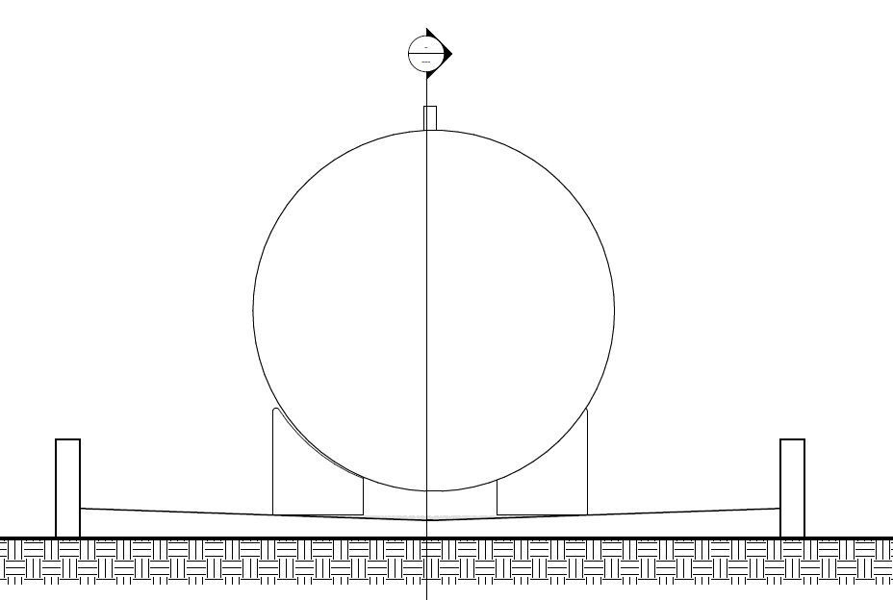
Show with no line or ‘joint here

